Slide 1
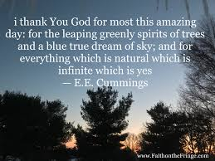
Opening Prayer

Slide 2
Laudato Si’
(Encyclical Letter)
On Care for Our Common Home
Pope Francis May 24, 2015

Slide 3
Introduction
Nothing in this world is indifferent to us
United by the same concern
St. Francis of Assisi

Slide 4
Chapter 1 - What is Happening to Our Common Home
Pollution and Climate Change
The Issue of Water
Loss of Biodiversity
Decline in the Quality of Human Life and the Breakdown of Society
Global Inequality
Weak Responses
A Variety of Opinions

Slide 5
Chapter 2 - The Gospel of Creation
The Light Offered by Faith
The Wisdom of the Biblical Accounts
The Mystery of the Universe
The Message of Each Creature in the Harmony of Creation
A Universal Communion
The Common Destination of Goods
The Gaze of Jesus

Slide 6
Chapter 3 - The Human Roots of the Ecological Crisis
Technology: Creativity and Power
The Globalization of the Technocratic Paradigm
The Crisis and Effects of Modern Anthropocentrism

Slide 7
Chapter 4 - Integral Ecology
Environmental, Economic and Social Ecology
Cultural Ecology
Ecology of Daily Life
The Principle of the Common Good
Justice Between the Generations

Slide 8
Chapter 5 - Lines of Approach and Action
Dialogue on the Environment in the International Community
Dialogue for New National and Local Policies
Dialogue and Transparency in Decision-Making
Politics and Economy in Dialogue for Human Fulfilment
Religions in Dialogue with Science

Slide 9
Chapter 6 - Ecological Education and Spirituality
Towards a New Lifestyle
Educating for the Covenant Between Humanity and the Environment
Ecological Conversion
Joy and Peace
Civic and Political Love
Sacramental Signs and the Celebration of Rest
The Trinity and the Relationship Between Creatures
Queen of All Creation
Beyond the Sun

Slide 10
Laudato Si’ Animators Course
https://catholicclimatemovement.global/

Slide 11
Laudato Si’ Animators Course
See
Judge
Act

Slide 12
Laudato Si’ Animators Course
See - week 1 - Dr. Peter Umunay webinar, special report on global warming, Lectio Divina with Creation
Judge
Act

Slide 13
Laudato Si’ Animators Course
See - week 1 - Dr. Peter Umunay webinar, special report on global warming, Lectio Divina with Creation
Judge - week 2 & 3 -Fr. Joshtrom and Amy Echeverria webinars. Laudato Si’ Chaplet, Ecological Examen
Act

Slide 14
Laudato Si’ Animators Course
See - week 1 - Dr. Peter Umunay webinar, special report on global warming, Lectio Divina with Creation
Judge - week 2 & 3 - Fr. Joshtrom and Amy Echeverria webinars. Laudato Si’ Chaplet, Ecological Examen
Act - week 4 & 5 - Action in Light of Our Faith, Preparation for our final project “Season of Creation”

Slide 15
Ecological Conversion
is about a change in our relationship with God, ourselves, and all of our brothers and sisters in creation. It is the realization that “living our vocation to be protectors of God’s handiwork is essential to a life of virtue; it is no an optional or a secondary aspect of our Christian experience.” (LS 217)

Slide 16
seasonofcreation.org

Slide 17
Laudato Si’ Chaplet
Text for this chaplet can be found in the resources tab on the Season’s of Creation website under the Catholic faith header.

Slide 18
Introductory Song of Praise
Taize "Laudate Omnes Gentes"
Praise, O peoples; Praise the Lord (Psalm 117)

Slide 19
The Canticle of the Creatures
by St. Francis of Assisi (1224 A.D.)
Praised be you, my Lord, with all your creatures,
Especially Sir Brother Sun,
who is the day and through whom you give us light.
And he is beautiful and radiant with great splendour;
and bears a likeness of you, Most High.
Praised be you, my Lord, through Sister Moon and the stars,
in heaven you formed them clear and precious and beautiful.
Praised be you, my Lord, through Brother Wind,
and through [Brother] Air, cloudy and serene, and every kind of weather
through whom you give sustenance to your creatures.
Praised be you, my Lord, through Sister Water,
who is very useful and humble and precious and chaste.
Praised be you, my Lord, through Brother Fire,
Through whom you light the night,
and he is beautiful and playful and robust and strong.
Praise be to you, my Lord, through our Sister Mother Earth,
who sustains and governs us,
and you produces various fruit with coloured flowers and herbs.

Slide 20
The Praise Verses
Praised be you, my Lord, through Brother Air. x10
Praised be you, my Lord, through Sister Water. x10
Praised be you, my Lord, through Brother Fire. x10
Praised be you, my Lord, through Sister Mother Earth. x10

Slide 22
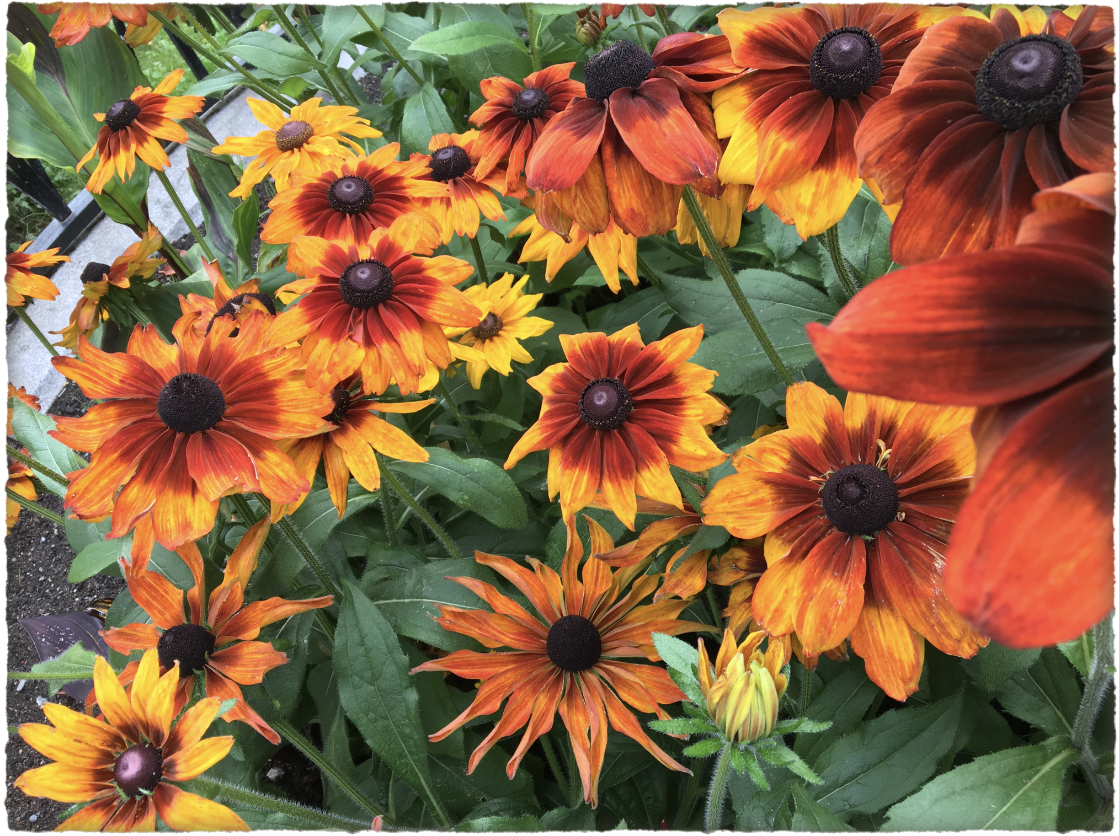
A prayer for our earth
All-powerful God, you are present in the whole universe
and in the smallest of your creatures.
You embrace with your tenderness all that exists.
Pour out upon us the power of you love,
that we may protect life and beauty.
Fill us with peace, that we may live
as brothers and sisters, harming no one.
O God of the poor,
help us to rescue the abandoned and forgotten of this earth,
so precious in your eyes.
Bring healing to our lives,
that we may protect the world and not prey on it,
that we may sow beauty, not pollution and destruction.
Touch the hearts
of those who look only for gain
at the expense of the poor and the earth.
Teach us to discover the worth of each thing,
to be filled with awe and contemplation,
to recognize that we are profoundly united
with every creature
as we journey towards your infinite light.
We thank you for being with us each day.
Encourage us, we pray, in our struggle
for justice, love and peace.
Pope Francis Laudato Si’

Slide 23
An Invitation!!!
Pray for and with creation
Live more simply
Advocate to protect our common home.
https://livelaudatosi.org/

